Slide 1
“US Equity Mean-Reversion Examined” with Ryan Roberts (Email: ryanrober@gmail.com & rr2452@columbia.edu ) and
“FX Optimal Pairs Examined” with Vu Nguyen (Email: nguyenvu@math.hawaii.edu )
Oct 12th, 2010
NYU Courant Institute
Jim K. Liew, Ph.D.
Oct 12th , 2010
5:30pm – 8:00 pm
Notes:
what do you want to gain from this course?
what do you think you need to make $$?

Slide 2
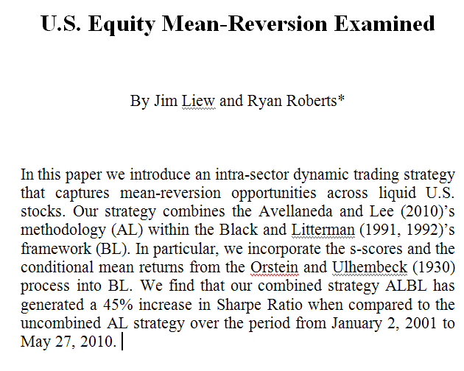
NYU Courant Jim K Liew

Slide 3
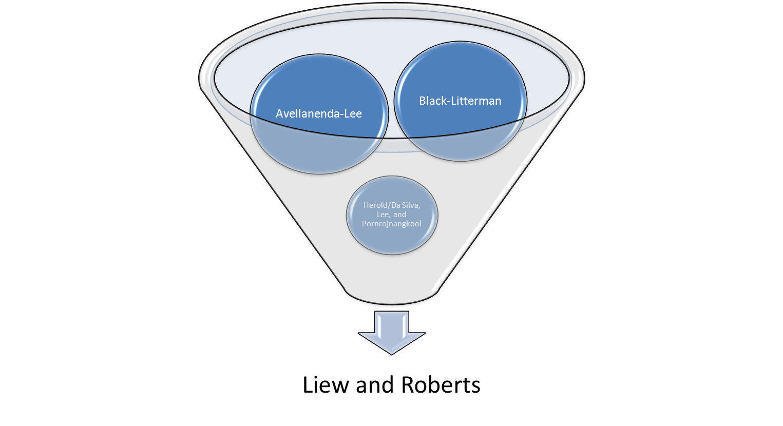
Road Map
Optimization Framework, that allows us to incorporate our priors and conviction-levels
Elegant mean-reversion methodology, defines and organizes terms
The glue to combine both. Implement the notion that equilibrium expected returns should be set to zero
NYU Courant Jim K Liew

Slide 4
Main Contribution
ALBL improves Sharpe Ratio of AL with a reasonable financial economic justification
Directly incorporate s-score into the BL optimization procedure
Employ conditional mean-returns as our views
Incorporate current thoughts on equilibrium expected returns for mean-reversion strategy, (i.e. equals zero)
US equity sectors are not created equal: the more complex the correlation structure (i.e. larger number of PCs for same level of explanation), the more fertile grounds for reversion-extraction
NYU Courant Jim K Liew

Slide 5
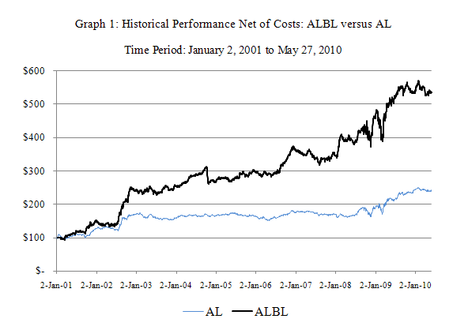
The main results…
Sharpe 1.225
Sharpe 0.843
NYU Courant Jim K Liew

Slide 6
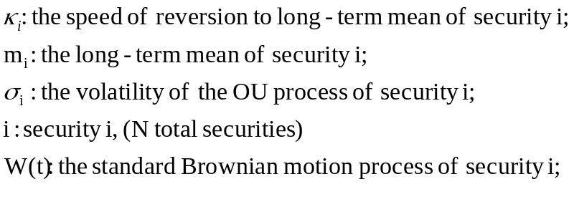

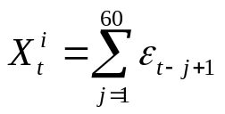

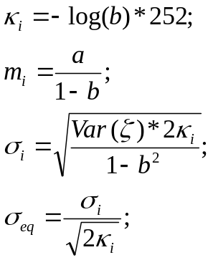
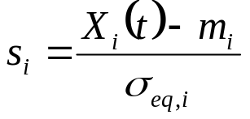
Background on AL
Parametric model for X_{i}(t), namely the Ornstein-Ulhembeck process:
With the following:
Step 1: Estimate time-series regression with 60-day of daily returns of security i regressed on 60-days of daily returns of ETF associated with security i :
Then sum the residuals from Step 1, this is the sum of residuals process:
Step 2: OU parameters are obtained from assuming AR(1) process and estimating the coefficients in a lag 1 regression model.
s-score defined as:
NYU Courant Jim K Liew

Slide 7
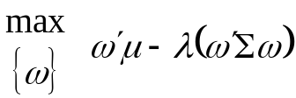
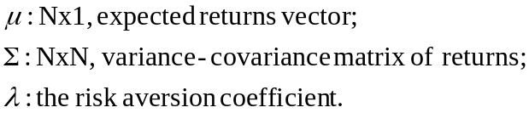


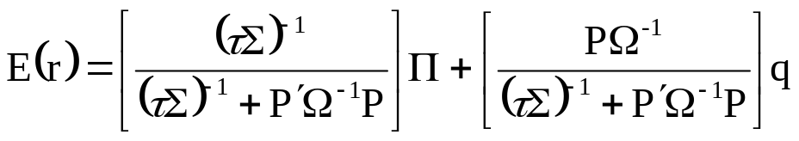
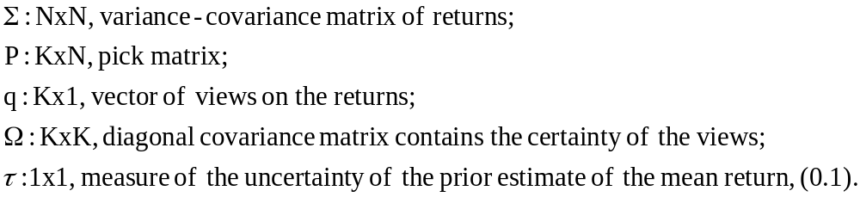
Background on BL
BL attempts to stabilize the optimal portfolio allocations by blending equilibrium expected returns with views.
Assume we have N assets:
The unconstrained solution is:
BL inverts this optimal solution to derive the equilibrium expected return vector by replacing, ω, with the market observed vector of weights: ω_{mkt}
Nx1, Equilibrium Expected Returns
Posterior expected returns is the weighted sum of equilibrium expected returns and views:
NYU Courant Jim K Liew

Slide 8
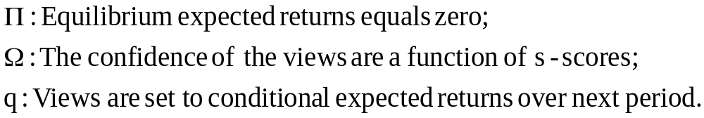
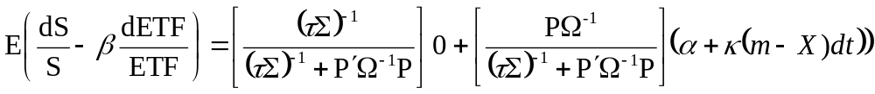
Combining AL and BL
Assume equilibrium expected returns to our market-neutral portfolio equals zero
Conditional expected returns to a market-neutral portfolio that is long $1 stock and short beta in ETF
NYU Courant Jim K Liew

Slide 9
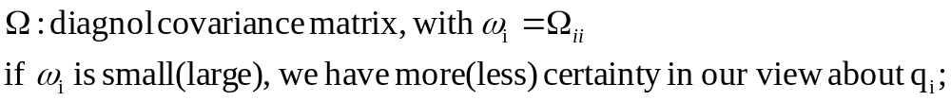
Certainty in Our Views
We define our measure of certainty of our views by taking s-scores and forming quintiles. Each quintile maps into confidence intervals which are a monotonically decreasing function with the following break-points [0.1, 0.01, 0.001, 0.0001, 0.00001]. Larger(smaller) s-scores values have larger(smaller) degree of confidence.
The basic idea is to put more emphasis on those s-score that are large (in absolute sense) thus gaining more exposure to those state-of-nature where mean-reversion should occur.
NYU Courant Jim K Liew

Slide 10
Detailed Results
Daily data from Yahoo, riddled with all the biases
Employ S&P500 constituents, across 9 GIC sectors, employ adjusted-closing prices to compute total returns.
T-costs assume $1 ticket charge and $0.003 per share
Summary Statistics
S-score Fan Graphs
PCs per Sector Results
NYU Courant Jim K Liew

Slide 11
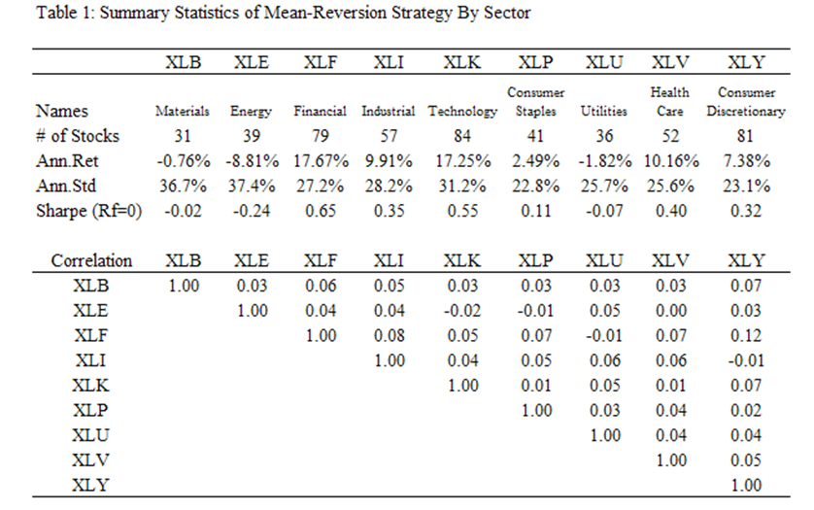
Summary Statistics
NYU Courant Jim K Liew

Slide 12
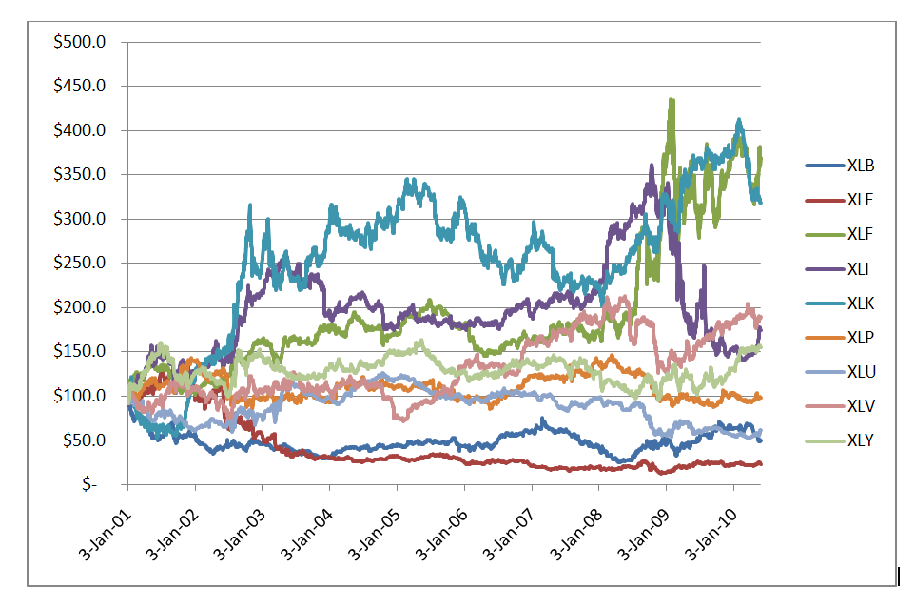
Graph 2: Cumulative Returns to Mean-Reversion Strategy Across Nine Sectors
NYU Courant Jim K Liew

Slide 13
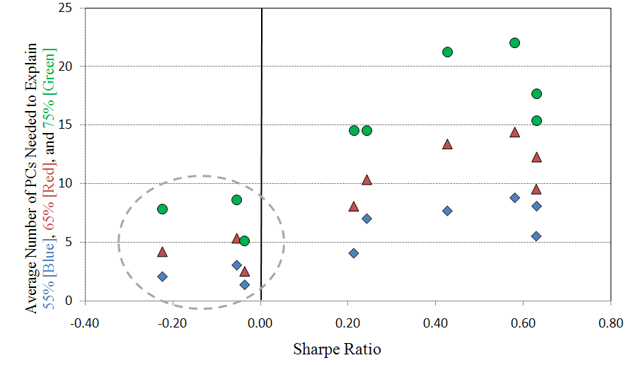
Graph 3: Average Number of PCs Needed to Explain Variation vs Sharpe Ratio
NYU Courant Jim K Liew

Slide 14
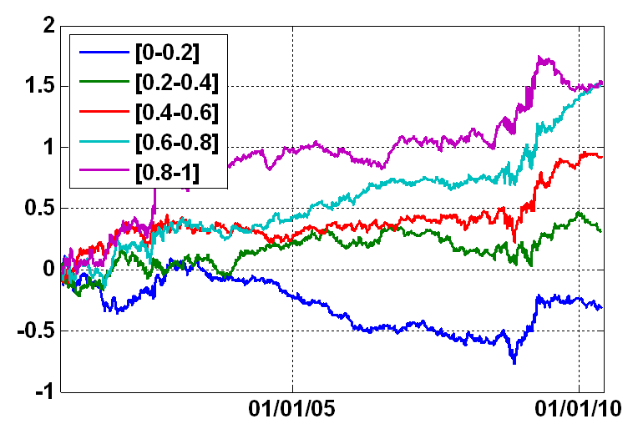
Graph 4: S-score Quintile Performance Over Time
NYU Courant Jim K Liew

Slide 15
Conclusions
First attempt to link AL and BL, with reasonable financial economic justification, results in higher Sharpe Ratio
  Employ s-scores as proxy for confidence in views and conditional mean returns for views
  Incorporate reasonable assumption of zero equilibrium returns to mean-reversion portfolio
Find evidence that s-score has useful informational content
Document benefits of mean-reversion in higher complex structures (i.e. larger number of PCs to explain same level of variation)
NYU Courant Jim K Liew

Slide 16
Optimal FX Pairs Examined
Oct 12th, 2010
NYU Courant Institute
By Jim Liew and Vu Nguyen
Email: jimkliew@gmail.com and nguyenvu@math.hawaii.edu

Slide 17
Contents
Main Results
Description
Currency Data Employed (14)
  Historical Daily Performance
Investment Opportunity Set
Pair Trading Procedure
Portfolio Formation
Results
Possible Enhancements
NYU Courant Jim K Liew

Slide 18
Description
Optimal FX Pairs strategy attempts to capture the dynamic opportunities of spread convergence for a given set of two pairs within the liquid currency markets.
The first step is to compute the exhaustive set of pairs, we employ the 14 most liquid currencies
The top pairs are identified by sorting each pairs by a given criteria (rolling 1-year Sharpe Ratio) and entered into the Optimal-Pairs portfolio. The constituents of the Optimal-Pairs portfolio may change over time as new pairs enter and exit accordingly
NYU Courant Jim K Liew

Slide 19
Currency Data Employed
The following currencies rates are included in the investment space:
Start Date: 7/1/2001, End Date: 9/2/2010 (daily data)
GPBUSD (British Pound) CADUSD (Canadian Dollar) DKKUSD (Danish Krone) AUDUSD (Australian Dollar) EURUSD (Euro) JPYUSD (Japanese Yen) NZDUSD (New Zealand Kiwi) | SEKUSD (Swedish Krona) CHFUSD (Swiss Franc) MXNUSD (Mexican Peso) NOKUSD (Norwegian Krone) SGDUSD (Singapore Dollar) ZARUSD (South Africa Rand) KRWUSD (South Korean Won)
NYU Courant Jim K Liew

Slide 20
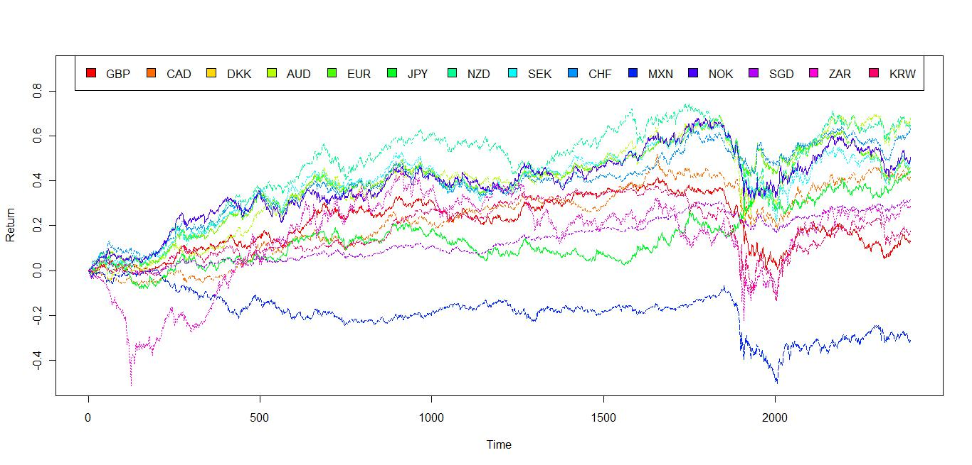
Historical Daily Performance of Currencies
NYU Courant Jim K Liew

Slide 21
Investment Opportunity Set
Pairs of currencies are assembled to perform mean-reversion process in the spirit of Avellaneda and Lee (2009) [AL]
Because of asymmetry, we have a total of 182 pairs of currencies (14² – 14)
The following table shows all the pairs in our investment space and their associated pairID
 | GBP | CAD | DKK | AUD | EUR | JPY | NZD | SEK | CHF | MXN | NOK | SGD | ZAR | KRW
GPB | 1 | 2 | 3 | 4 | 5 | 6 | 7 | 8 | 9 | 10 | 11 | 12 | 13 | 14
CAD | 15 | 16 | 17 | 18 | 19 | 20 | 21 | 22 | 23 | 24 | 25 | 26 | 27 | 28
DKK | 29 | 30 | 31 | 32 | 33 | 34 | 35 | 36 | 37 | 38 | 39 | 40 | 41 | 42
AUD | 43 | 44 | 45 | 46 | 47 | 48 | 49 | 50 | 51 | 52 | 53 | 54 | 55 | 56
EUR | 57 | 58 | 59 | 60 | 61 | 62 | 63 | 64 | 65 | 66 | 67 | 68 | 69 | 70
JPY | 71 | 72 | 73 | 74 | 75 | 76 | 77 | 78 | 79 | 80 | 81 | 82 | 83 | 84
NZD | 85 | 86 | 87 | 88 | 89 | 90 | 91 | 92 | 93 | 94 | 95 | 96 | 97 | 98
SEK | 99 | 100 | 101 | 102 | 103 | 104 | 105 | 106 | 107 | 108 | 109 | 110 | 111 | 112
CHF | 113 | 114 | 115 | 116 | 117 | 118 | 119 | 120 | 121 | 122 | 123 | 124 | 125 | 126
MXN | 127 | 128 | 129 | 130 | 131 | 132 | 133 | 134 | 135 | 136 | 137 | 138 | 139 | 140
NOK | 141 | 142 | 143 | 144 | 145 | 146 | 147 | 148 | 149 | 150 | 151 | 152 | 153 | 154
SGD | 155 | 156 | 157 | 158 | 159 | 160 | 161 | 162 | 163 | 164 | 165 | 166 | 167 | 168
ZAR | 169 | 170 | 171 | 172 | 173 | 174 | 175 | 176 | 177 | 178 | 179 | 180 | 181 | 182
KRW | 183 | 184 | 185 | 186 | 187 | 188 | 189 | 190 | 191 | 192 | 193 | 194 | 195 | 196
*Blue cells contain pairs that are ignored.
NYU Courant Jim K Liew

Slide 22
Pair Trading Procedure
NYU Courant Jim K Liew

Slide 23


Pair Trading Procedure
We present a walkthrough of the AL signal generation process for the pair GBP and CAD.
Let
  = 60, the rolling window length in days
  be a vector of daily returns for the British Pound of length
  be a vector of daily returns for the Canadian Dollar of length
NYU Courant Jim K Liew

Slide 24








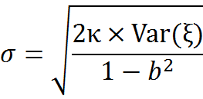
Pair Trading Procedure (cont’d)
Step 1: Perform a linear regression between 2 return vectors
Step 2: Estimate the parameters of the process
(Ornstein-Uhlembeck process)
Step 3: Perform a linear regression between and (AR(1))
Step 4: The parameters are recovered by the following formulas
NYU Courant Jim K Liew

Slide 25

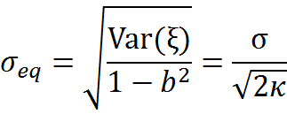
Pair Trading Procedure (cont’d)
where
  is the mean-reversion rate
  long-term mean
  is the volatility
  The long-term standard deviation is given by the following formula
NYU Courant Jim K Liew

Slide 26

Pair Trading Procedure (cont’d)
The s-score is a dimensionless variable defined as follows
The s-score measures the distance to long-term mean in units long-term standard deviation, i.e. how far away GBP is from the theoretical equilibrium with CAD.
If the s-score is too high, we believe that GPBUSD is over-priced and/or CADUSD is under-priced, and vice versa, If the s-score is too low, then GPBUSD is under-priced and/or CADUSD is over-priced.
NYU Courant Jim K Liew

Slide 27
Pair Trading Procedure (cont’d)
Thresholds for s-score are taken from AL framework:
We then trade accordingly:
  If s < -1.25, we enter a trade by buying 1 dollar of GPB and short-selling β dollar of CAD (where β is from Step 1). When s > -0.5, we close the position by selling GPB and buying CAD.
  If s > 1.25, we short-sell 1 dollar of GBP and buy β dollar of CAD. When s < 0.75, we close the position by buying GBP and selling CAD.
Buy to open: -1.25 | Sell to open: 1.25
Sell to close: -0.50 | Buy to close: 0.75
NYU Courant Jim K Liew

Slide 28
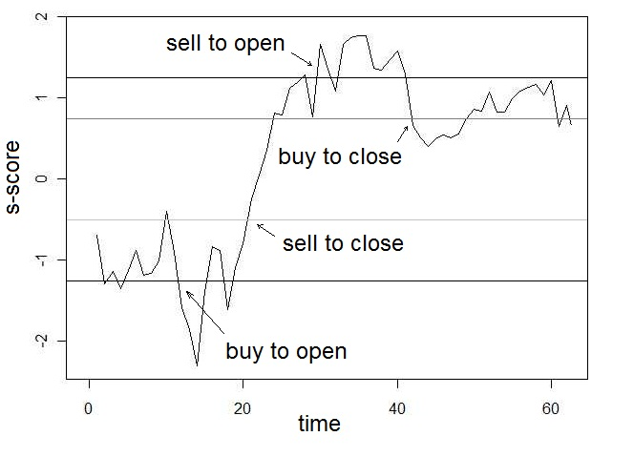
Pair Trading Procedure (cont’d)
NYU Courant Jim K Liew

Slide 29
Portfolio Formation
NYU Courant Jim K Liew

Slide 30
Portfolio Formation
After the warm-up period of 252 trading days, portfolios of optimal pairs are constructed
  “Optimal” is defined in term of the rolling 252-day Sharpe’s ratio (assuming risk-free is 0) (we opt to wait for 252 days for portfolio stability)
  Sort pairs based on their Sharpe,
  and, add the top performers to portfolios (here we examine the top 10-, 20-, 50-, and 90- portfolios)
NYU Courant Jim K Liew

Slide 31
Portfolio Formation (detail)
Portfolio constituent pairs may change over time, but they satisfy these two conditions:
  If a track is currently in position, no new pair can replace the pair currently in this track. This is to prevent closing position in the middle of a mean-reversion process (premature closes).
  We do not open a position for a track that just got a new pair until we receive the next opening signal. This is to prevent opening position in the middle of a mean-reversion process (late opens)
NYU Courant Jim K Liew

Slide 32
Results
NYU Courant Jim K Liew

Slide 33
Here we present results from the strategy. We reiterate the assumptions:
  No transaction costs
  No leverage
  S-score thresholds are
Buy to open: -1.25 | Sell to open: 1.25
Sell to close: -0.50 | Buy to close: 0.75
NYU Courant Jim K Liew

Slide 34
Yearly Returns
Year | Equally-weighted | Top-10 | Top-20 | Top-50 | Top-90
1st | 0.33 | 0.00 | 0.00 | 0.00 | 0.00
2nd | 0.61 | 0.31 | 0.37 | 0.36 | 0.12
3rd | -0.47 | 3.00 | 1.87 | 0.84 | 0.23
4th | 0.88 | 1.78 | 2.18 | 1.77 | 1.18
5th | 0.82 | 2.38 | 1.78 | 1.13 | 0.94
6th | 0.29 | 0.26 | -0.27 | -0.33 | -0.20
7th | 0.30 | -0.92 | -0.02 | 0.14 | 0.38
8th | 1.44 | 1.55 | 3.32 | 1.65 | 1.65
9th | 0.83 | 2.75 | 5.21 | 2.32 | 1.57
10th (125 days) | 0.52 | 2.69 | 2.22 | 0.88 | 0.28
Total | 5.55 | 13.80 | 16.66 | 8.76 | 6.15
NYU Courant Jim K Liew

Slide 35
Annualized Sharpe
Year | Equally-weighted | Top-10 | Top-20 | Top-50 | Top-90
1st | 0.5378 | N/A | N/A | N/A | N/A
2nd | 0.9369 | 0.2863 | 0.2982 | 0.4168 | 0.1539
3rd | -0.4257 | 1.4196 | 1.0429 | 0.6506 | 0.1896
4th | 0.9135 | 0.906 | 1.4136 | 1.6056 | 1.3104
5th | 1.0565 | 2.1202 | 1.8184 | 1.2558 | 1.2354
6th | 0.3609 | 0.2688 | -0.3151 | -0.4123 | -0.2619
7th | 0.3306 | -0.3834 | -0.013 | 0.0831 | 0.2929
8th | 0.7421 | 0.7649 | 1.8107 | 0.8053 | 0.8536
9th | 0.7071 | 0.9353 | 1.6859 | 1.1625 | 1.0405
10th (125 days) | 0.9546 | 2.0677 | 2.0906 | 1.0556 | 0.4115
Overall | 0.5436 | 0.7531 | 1.0308 | 0.6734 | 0.5573
NYU Courant Jim K Liew

Slide 36
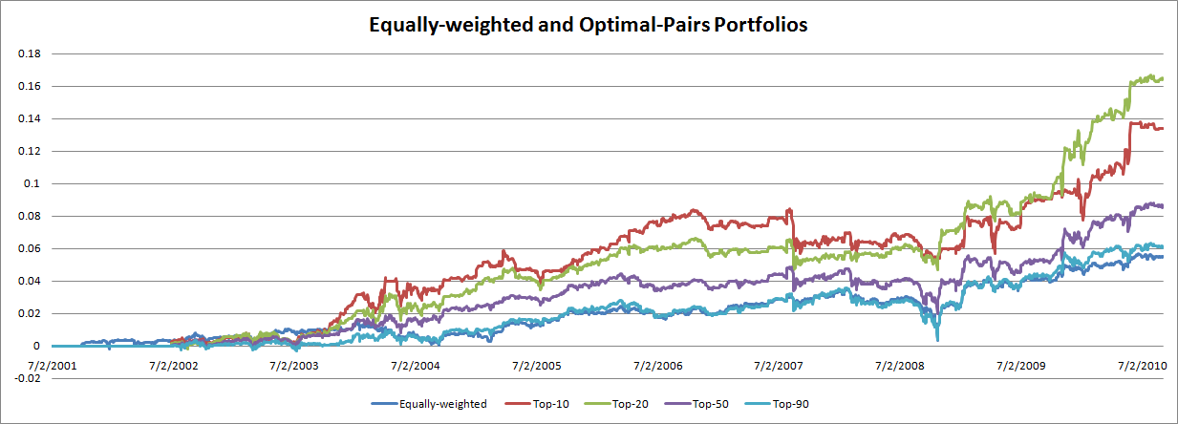
Cumulative Returns
NYU Courant Jim K Liew

Slide 37
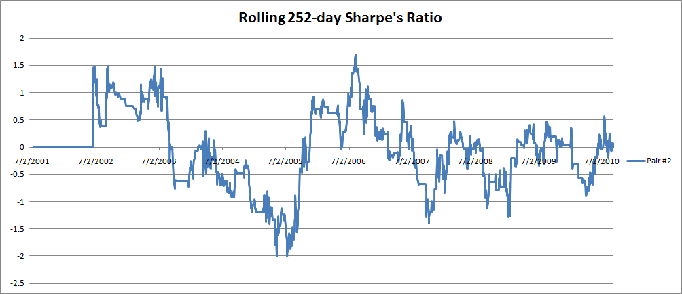
Rolling Sharpe Ratio (252 days)
Rolling Sharpe’s ratio for pair #2 (i.e., GBP against CAD)
NYU Courant Jim K Liew

Slide 38
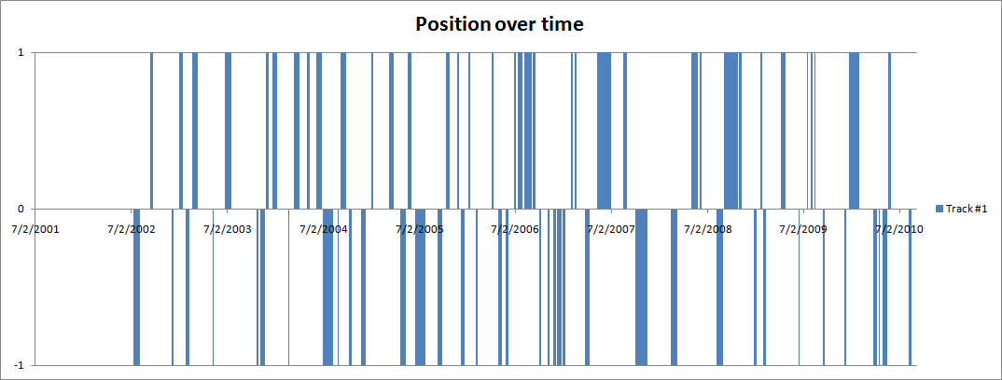
Example of Positions over Time
NYU Courant Jim K Liew

Slide 39
Threshold Improvement
Since the original threshold set was meant for U.S. stocks, we performed back-testing analysis to find a better set for FX-14.
We include here the results from a better set
Buy to Open: -1.75 | Sell to Open: 1.75
Sell to Close: -0.35 | Buy to Close: 0.50
NYU Courant Jim K Liew

Slide 40
Thresholds Improvement (Yearly Returns)
 | Equally-weighted | Top-10 | Top-20 | Top-50 | Top-90
1st | 0.21 | 0.00 | 0.00 | 0.00 | 0.00
2nd | 0.32 | 0.83 | 0.49 | 0.70 | 0.39
3rd | 0.30 | 0.23 | 1.00 | 0.60 | 0.89
4th | 0.50 | 1.30 | 1.76 | 1.31 | 1.13
5th | 0.52 | 0.55 | 0.69 | 0.78 | 0.57
6th | 0.41 | 0.63 | 0.97 | 0.57 | 0.61
7th | 0.41 | 0.26 | 0.45 | 0.00 | 0.42
8th | 0.62 | -0.15 | 2.27 | 1.54 | 0.29
9th | 0.95 | 2.36 | 2.01 | 1.59 | 1.02
10th (125 days) | 0.59 | 1.29 | 1.31 | 0.81 | 0.59
Total | 4.83 | 7.30 | 10.95 | 7.90 | 5.91
NYU Courant Jim K Liew

Slide 41
Thresholds Improvement
 | Equally-weighted | Top-10 | Top-20 | Top-50 | Top-90
1st | 0.7611 | N/A | N/A | N/A | N/A
2nd | 0.6648 | 0.8994 | 0.5817 | 1.2081 | 0.7745
3rd | 0.3883 | 0.1725 | 0.9311 | 0.6407 | 1.0182
4th | 0.7552 | 0.6038 | 1.0606 | 1.4028 | 1.5486
5th | 1.0093 | 0.5093 | 0.8088 | 1.2185 | 1.0354
6th | 0.7285 | 0.3556 | 0.7459 | 0.6178 | 0.8946
7th | 0.7607 | 0.0816 | 0.2305 | 0 .0000 | 0.5016
8th | 0.4007 | -0.0938 | 1.6188 | 1.0962 | 0.2125
9th | 1.1828 | 1.3649 | 1.2421 | 1.4236 | 1.1505
10th (125 days) | 1.4371 | 1.1499 | 1.7496 | 2.0237 | 1.6019
Overall | 0.6614 | 0.4344 | 0.8757 | 0.8569 | 0.7803
NYU Courant Jim K Liew

Slide 42
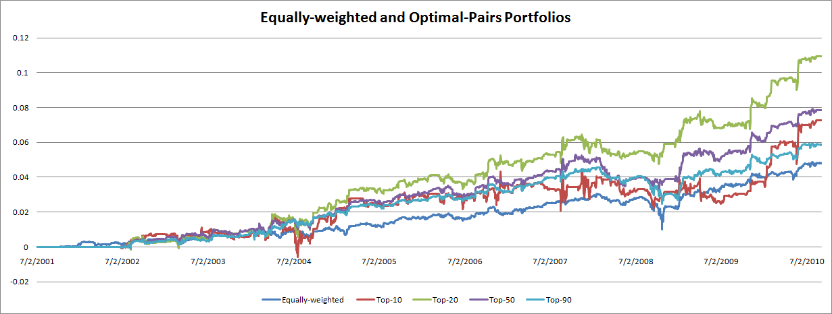
Cumulative Returns
NYU Courant Jim K Liew

Slide 43
Possible Enhancements
Mean-Reversion allocation on open tracks
Adaptive buy/sell thresholds (s-score)
Apply trade-time/drift
Optimize parameters and/or sorting criteria
Switching to trend and/or stop trading when VIX approaches certain threshold (see next page)
Extend to 1-minute intraday FX
Extend model to different asset classes (ETFs, Equities, Stocks, etc.)
NYU Courant Jim K Liew

Slide 44
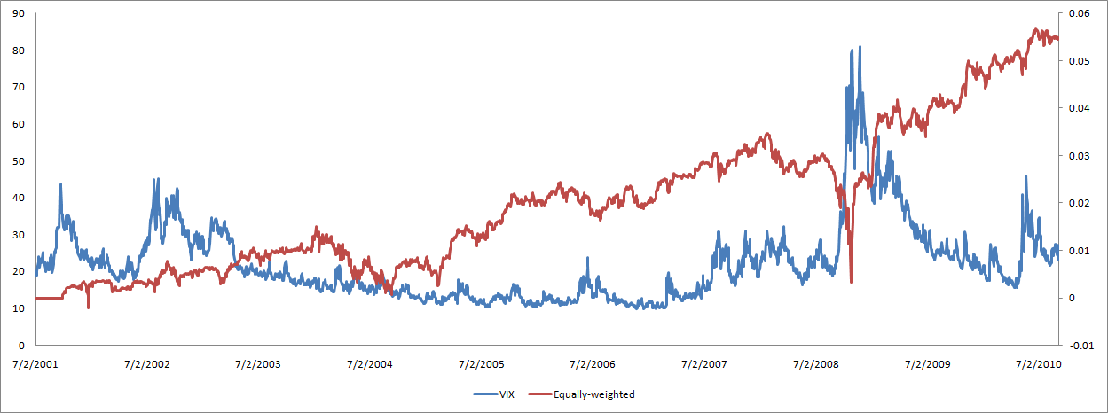
Difficult Performance in Periods of High Uncertainty
NYU Courant Jim K Liew

Slide 45
Appendix – Effect of Transaction Costs
Here we present the strategy (new thresholds) with transaction costs.
Costs are below:
Table of costs
NYU Courant Jim K Liew

Slide 46
Appendix – Effect of Transaction Costs
 | Equally-weighted | Top-10 | Top-20 | Top-50 | Top-90
1st | -0.19 | 0.00 | 0.00 | 0.00 | 0.00
2nd | -0.24 | -0.17 | 0.09 | 0.53 | 0.03
3rd | -0.37 | -0.15 | 0.97 | 0.52 | 0.29
4th | -0.28 | 0.58 | 1.11 | 0.79 | 0.61
5th | -0.32 | 0.37 | 0.36 | 0.43 | 0.22
6th | -0.31 | -0.05 | -0.21 | 0.11 | 0.19
7th | -0.17 | 0.25 | 0.87 | 0.21 | -0.04
8th | 0.01 | 0.41 | 1.94 | 0.93 | -0.15
9th | 0.09 | -0.58 | 0.04 | 0.70 | 0.47
10th (252 days) | 0.22 | 0.68 | 0.53 | 0.55 | 0.32
Overall | -1.56 | 1.34 | 5.7 | 4.77 | 1.94
NYU Courant Jim K Liew

Slide 47
Appendix – Effect of Transaction Costs
 | Equally-weighted | Top-10 | Top-20 | Top-50 | Top-90
1st | -0.6999 | N/A | N/A | N/A | N/A
2nd | -0.4951 | -0.2254 | 0.1318 | 0.9280 | 0.0619
3rd | -0.4811 | -0.1261 | 0.9490 | 0.6090 | 0.3488
4th | -0.4246 | 0.3649 | 0.8132 | 0.9769 | 0.8564
5th | -0.6045 | 0.3470 | 0.4420 | 0.7123 | 0.4056
6th | -0.5452 | -0.0342 | -0.1821 | 0.1280 | 0.3003
7th | -0.3044 | 0.1020 | 0.4227 | 0.1755 | -0.0548
8th | 0.0051 | 0.2680 | 1.5199 | 0.7066 | -0.104
9th | 0.1102 | -0.3750 | 0.0336 | 0.7005 | 0.5626
10th (252 days) | 0.5364 | 1.2561 | 0.8316 | 1.3330 | 0.8266
Overall | -0.2123 | 0.1043 | 0.5085 | 0.575 | 0.2553
NYU Courant Jim K Liew

Slide 48
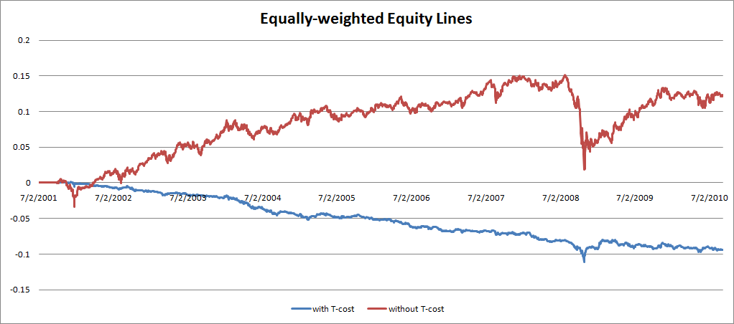
Appendix – Effect of Transaction Costs (Update plot)
NYU Courant Jim K Liew

Slide 49
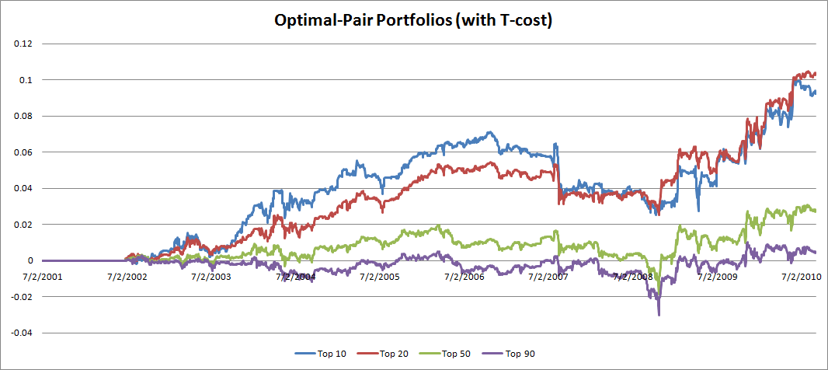
Appendix – Effect of Transaction Costs (Update plot)
NYU Courant Jim K Liew

